Slide 1
Recell Pricing Strategy Analysis
PGP-DSBA _ Recell Project
October 26, 2023

Slide 2
Contents / Agenda
Executive Summary
Business Problem Overview
Solution Approach
EDA Results
Data Preprocessing
Model Building
Model Performance Summary
Appendix

Slide 3
Executive Summary (1/2)
The model is able to explain ~84% of the variation in the data and within 4.56% of the normalized price of used devices on the test data; we can, thus, conclude that the model is good for prediction and inference
All other variables held constant, the increase of the normalized price of a new device by one unit results in an increase of the normalized price of an equivalent old device by 0.4415 units
The increase of the main camera resolution by one megapixel results in an increase of the normalized price of the corresponding old device by 0.0210 units, all other variables held constant
The normalized price of an old Xiaomi device, on average, will be 0.0801 units higher than that of an old device of any of the brands not included in the final model, all other variables held constant
Strangely, on average, the normalized price of an old iOS device would be 0.09 units less than that of on an old Android or Window device, all other variables held constant
The normalized price of an old 4g-enabled device is 0.0502 units higher than that of an old device that is not 4g-enabled, all other variables held constant

Slide 4
Executive Summary (2/2)
Another surprising observation: The normalized price of an old 5g-enabled device is 0.0673 units less than that of a non 5g-enable old device, all other variables held constant
Considering the relatively small numbers of devices with brands such as Xiaomi, iOS devices, and 5g-enabled devices, Recell might want to update the model some months or years later when a larger amount of the devices will have been sold and, thus, determine whether there has been any significant change in the model
Other parameters such as the network operators and geographical location where the sales were carried out might help improve the model and better predict suitable prices for old and refurbished devices
In the meantime, the startup can use the present model of price fixing within a 95% confidence interval
Considering the high correlation between the normalized prices of old and new devices and the significance of the price influence of new devices on the corresponding prices of old devices in the model, the startup might find it profitable to concentrate its sale on refurbished high-end (expensive) devices

Slide 5
Business Problem Overview
Increased demand for cheap and affordable telecommunications gadgets has boosted the market for used and refurbished devices as underscored by the Compound Annual Growth Rate (CAGR) of 13.6% from 2018 to 2023 projected by the IDC (International Data Corporation)
The startup, Recell, seeks to make the most of this growing market and my services as Data Scientist have been requested to aid the company model an optimal pricing policy
My task consist of using machine learning to develop a dynamic pricing strategy for used and refurbished devices, building a linear regression prediction model that clearly identifies and assesses the impact of principal factors on the market prices of these devices and using data collected in 2021 about the sale of devices released between 2013 and 2020

Slide 6
Solution Approach
The method used for this analysis consist of the following steps:
Exploratory Data Analysis of the data collected to identify trends and characteristics of the recorded attribute
Data Preprocessing to identify and treat duplicate entries, missing values, and outliers, and to engineer and prepare identified features necessary for the target model
Design of the model (Ordinary Least Squares - OLS) and Analysis of its Performance

Slide 7
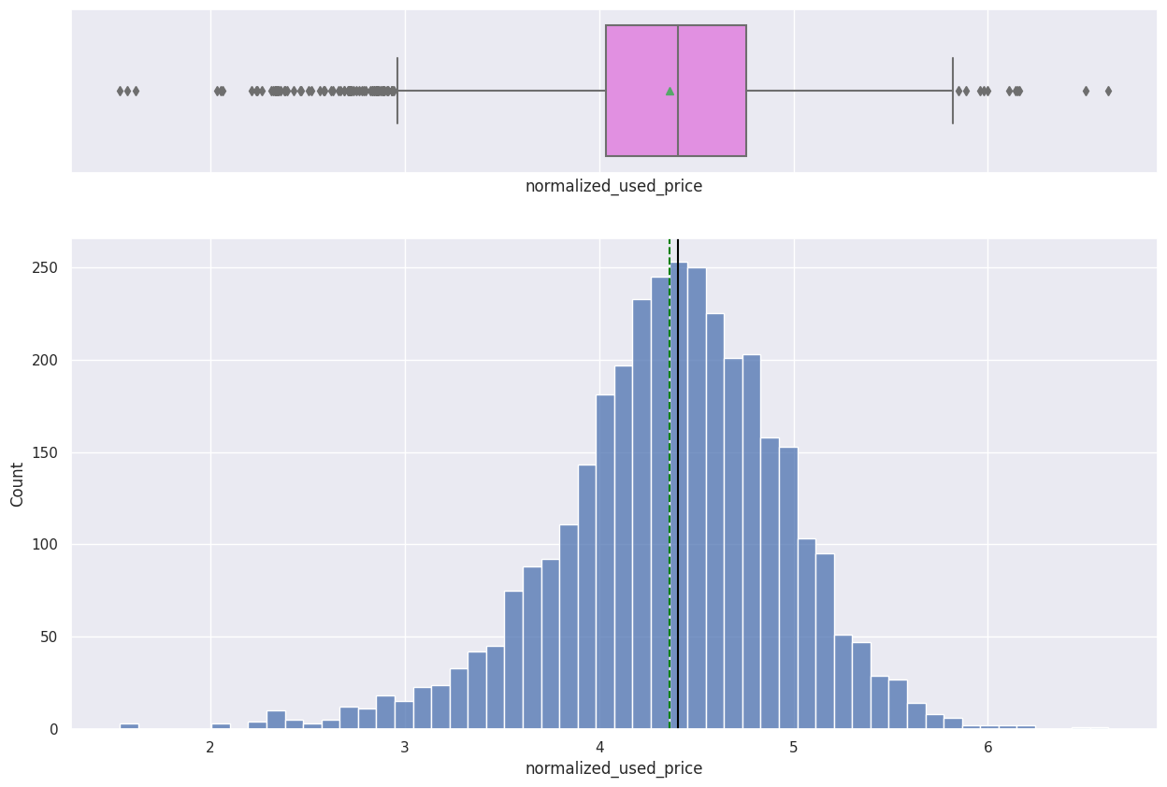
EDA Results: Univariate Analysis: Normalized Price of Used Devices
The normalized price of used devices is approximately normal with outliers on both sides of the distribution
The median value is slightly less than 4.5
Link to Appendix slide on data background check

Slide 8
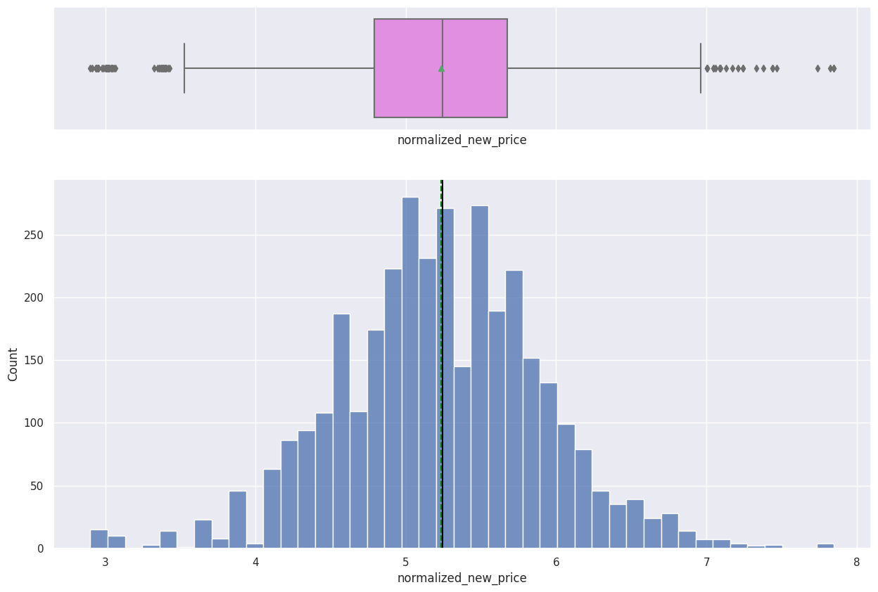
EDA Results: Univariate Analysis: Normalized Price of New Devices
The normalized price of new devices is approximately normal with outliers on both sides of the distribution
The median and mean values are approximately 5.2
Link to Appendix slide on data background check

Slide 9
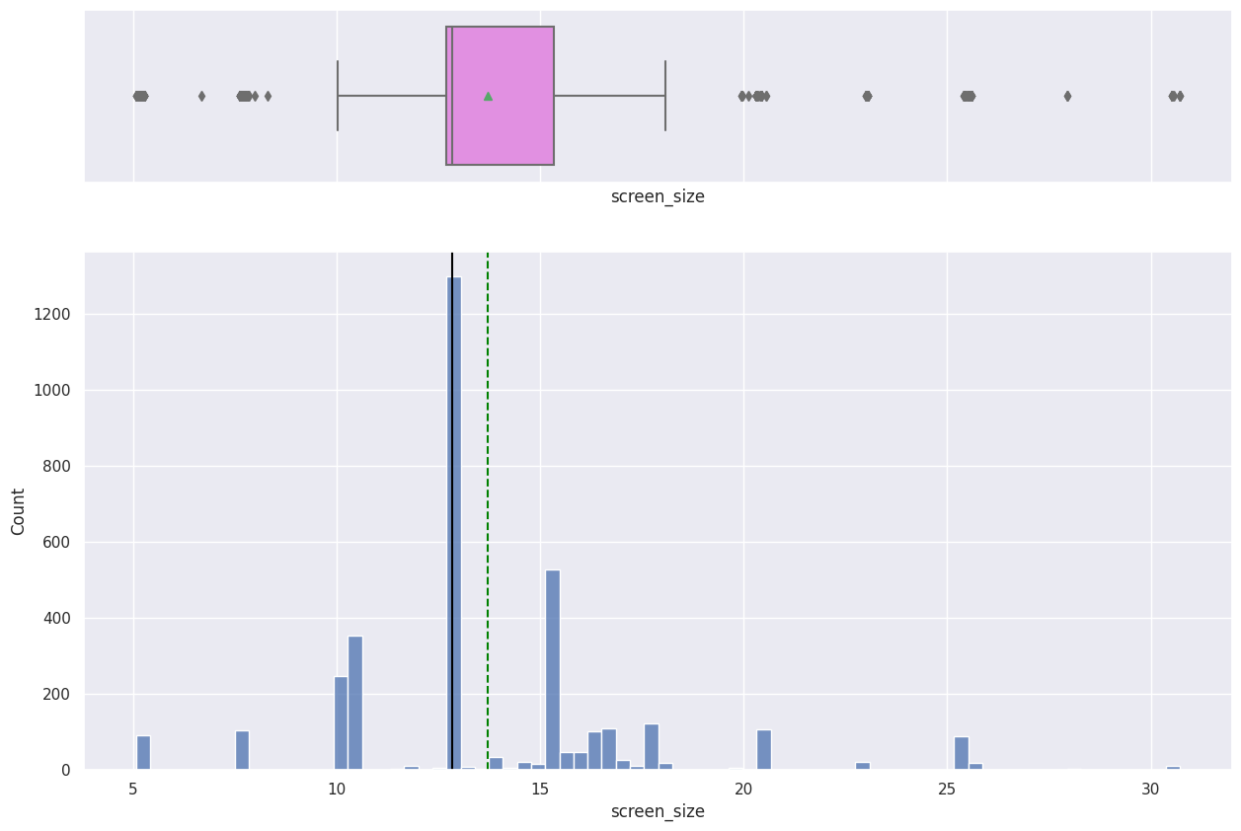
EDA Results: Univariate Analysis: Screen Size
The distribution of the screen size is sparse and right-skewed, and contains outliers on both sides of the distribution
The average screen size is about 14 cm while the median value is about 13 cm
Link to Appendix slide on data background check

Slide 10
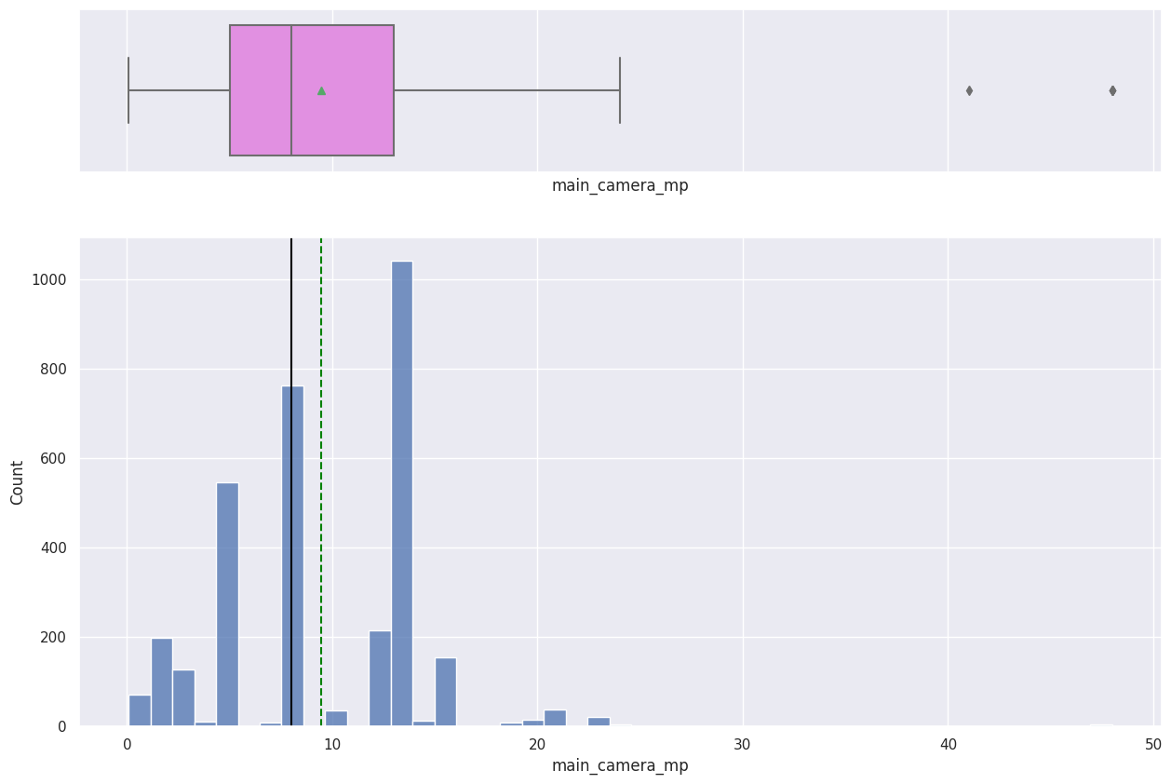
EDA Results: Univariate Analysis: Main Camera Resolution
The distribution of the main camera resolution is slightly right-skewed and multimodal
The average value is a little less than 10 megapixels whereas the median is about 8 megapixels
Link to Appendix slide on data background check

Slide 11
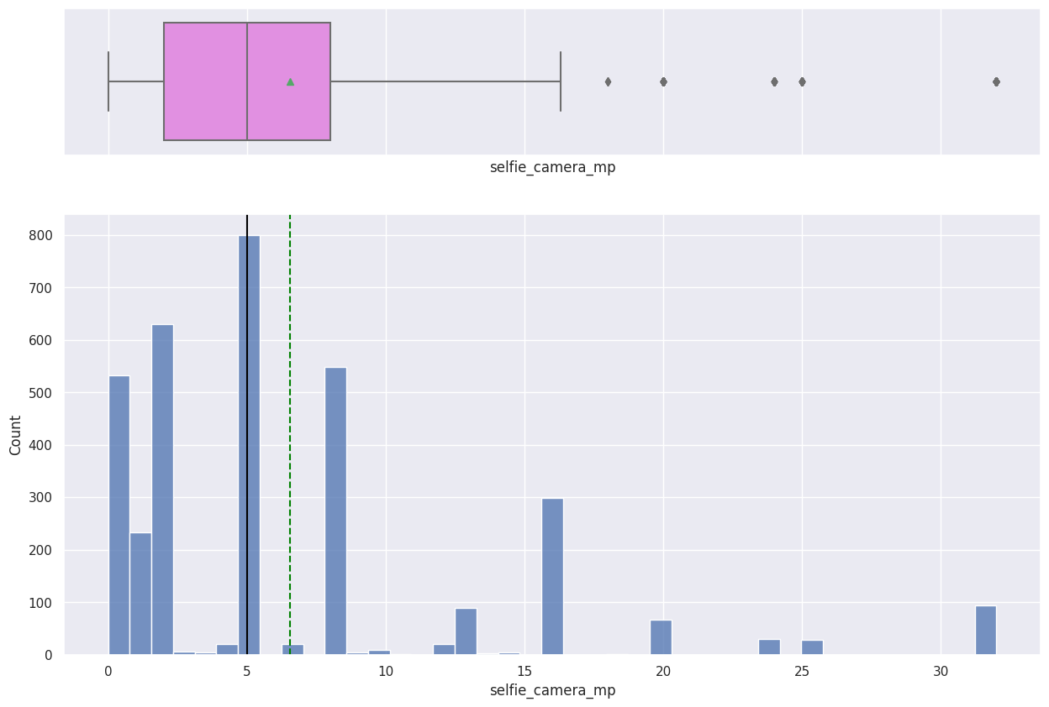
EDA Results: Univariate Analysis: Selfie Camera Resolution
The distribution of the selfie camera resolution is slightly right-skewed and contains upper outliers
The median is 5 megapixels meanwhile the average value is about 7 megapixels
Link to Appendix slide on data background check

Slide 12
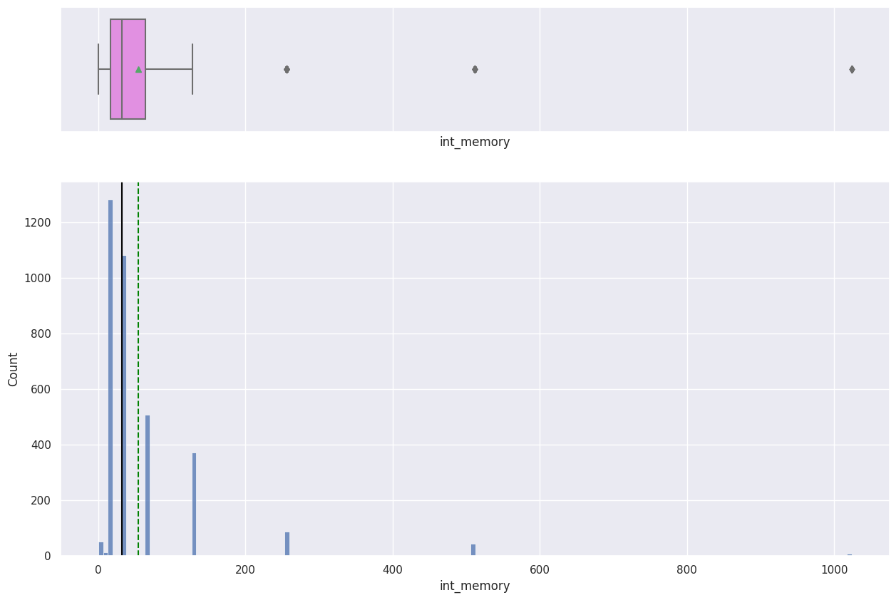
EDA Results: Univariate Analysis: Internal Memory
The distribution of the internal memory is right-skewed and contains very large upper outliers
Both the median and mean are below 100 GB
Link to Appendix slide on data background check

Slide 13
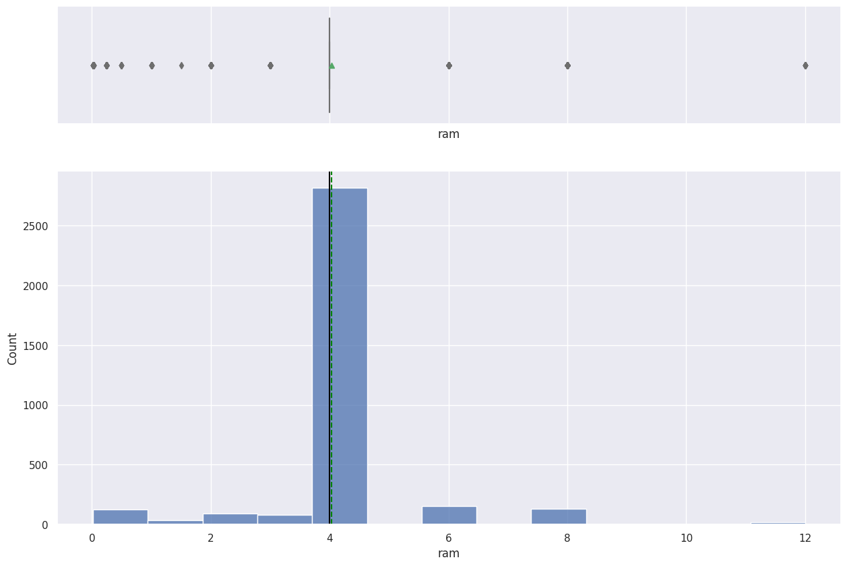
EDA Results: Univariate Analysis: Random Access Memory
The ram distribution has outliers on both sides of the distribution, particularly large on the right
Most of the devices have ram sizes that are very close to 4 GB and there is little or no variation in the distribution
Link to Appendix slide on data background check

Slide 14
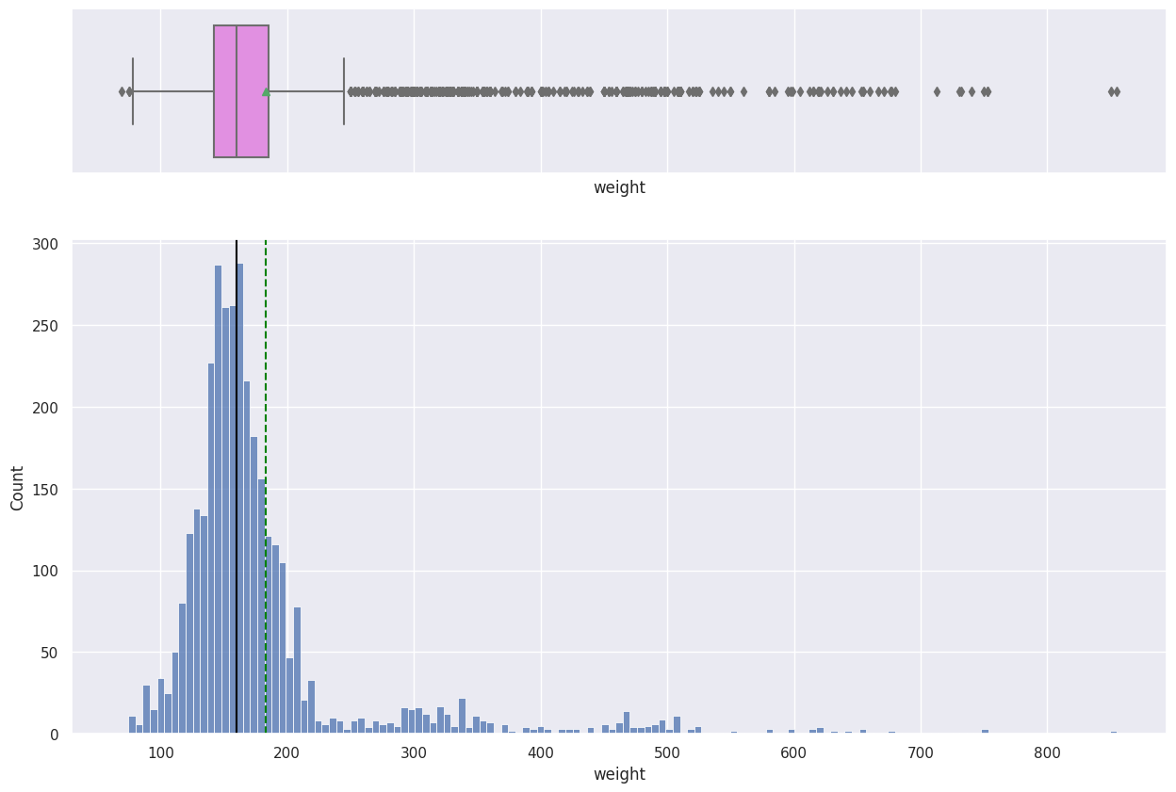
EDA Results: Univariate Analysis: Weight
The distribution of device weights is approximately symmetrical for most of the data but has several and very large upper outliers
The median is about 60 grams, approximately 20 grams less than the average
Link to Appendix slide on data background check

Slide 15
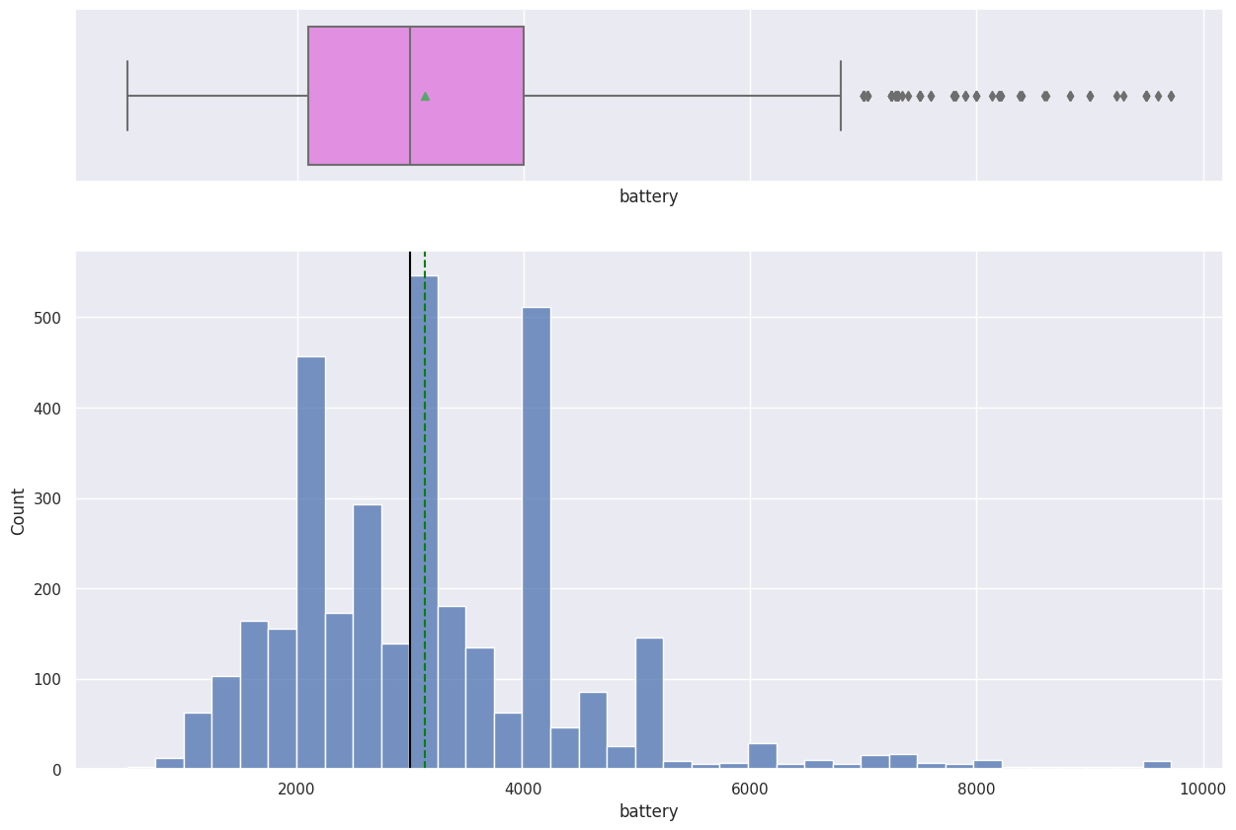
EDA Results: Univariate Analysis: Battery
The battery distribution is also approximately symmetrical for the most part but contains several upper outliers
The median, slightly lower than the average, is about 3000 mAh
Link to Appendix slide on data background check

Slide 16
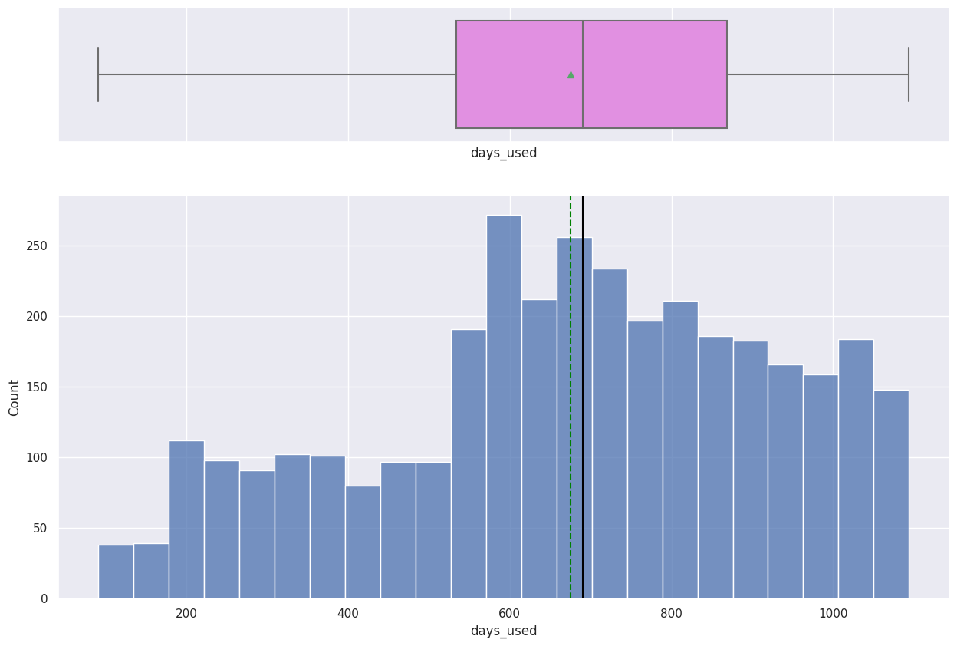
EDA Results: Univariate Analysis: Days Used
The number of days used is slightly left-skewed
The median, slightly larger than the mean, is about 700 days
Link to Appendix slide on data background check

Slide 17
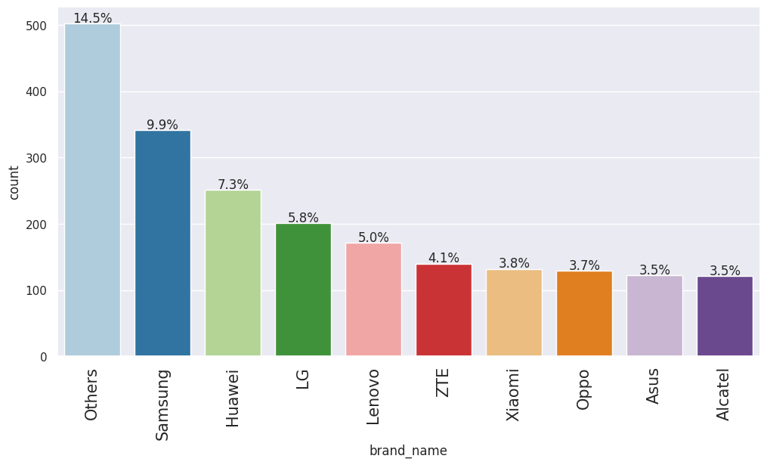
EDA Results: Univariate Analysis: Brand Name
Samsung is the most used brand (9.9%) followed by Huawei (7.3%)
Alcatel and Asus are the least used brands (3.5% each)
Link to Appendix slide on data background check

Slide 18
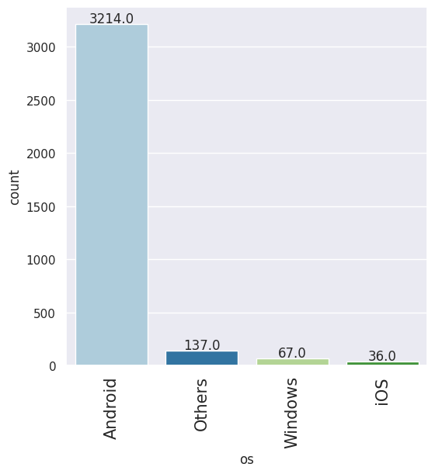
EDA Results: Univariate Analysis: Operating System
Android is by far the most used operating system (3214)
The other known operating systems are Windows (67) and iOS (36)
Link to Appendix slide on data background check

Slide 19
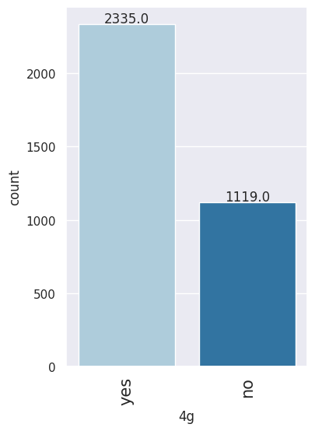
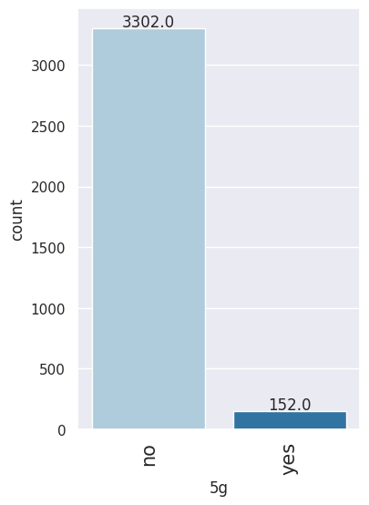
EDA Results: Univariate Analysis: 4g and 5g technologies
We have visual confirmation that most of the devices are 4g-compatible (2335 against 1119 non-compatible devices)
Almost all the devices are not 5g compatible (3302 vs 152 5g compatible devices)
Link to Appendix slide on data background check

Slide 20
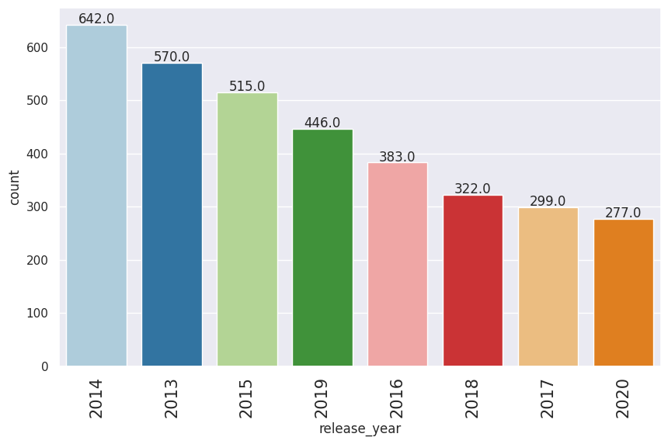
EDA Results: Univariate Analysis: Release Year
The number of devices per year shows an irregular pattern across the years but has generally decreased from 2013 (570) to 2020 (277)
Link to Appendix slide on data background check

Slide 21
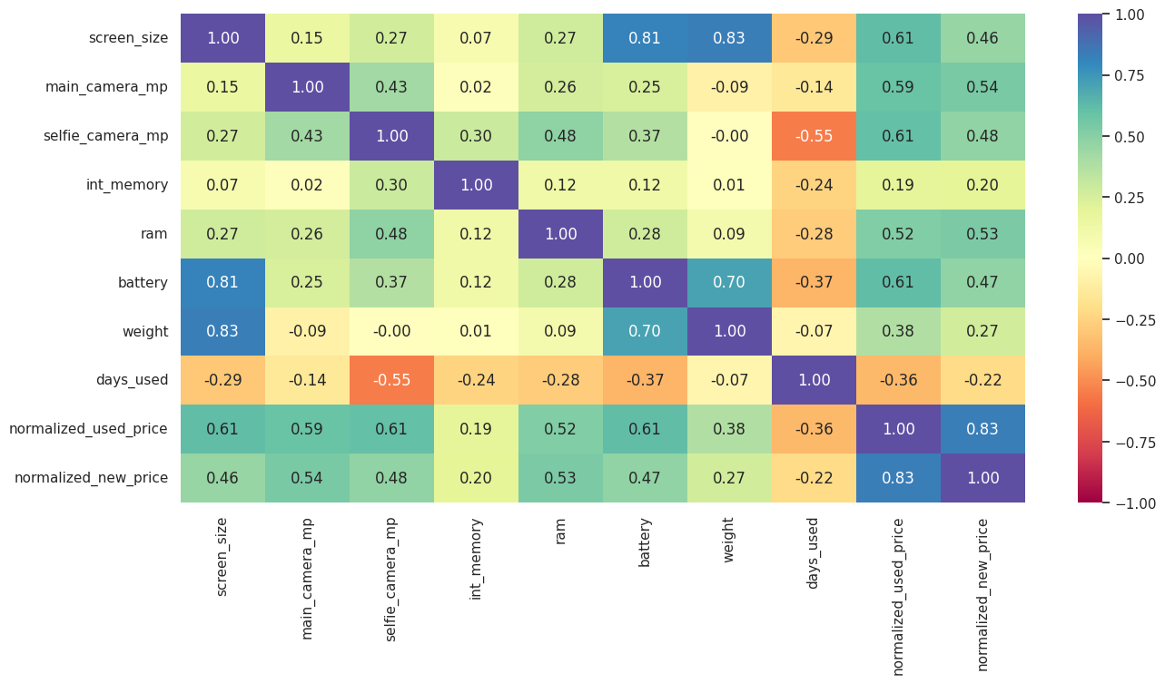
EDA Results: Bivariate Analysis: Correlation
The normalized price of used devices shows moderate positive correlation with the screen size, the main and selfie camera resolutions, the ram, and the battery; and strong positive correlation with the equivalent price of new devices
The screen size shows strong positive correlation with the weight and battery and moderate positive correlation with the normalized price of used devices
The normalized prices of new devices also show moderate positive correlation with the main camera resolution and the ram
The weight and battery show strong positive correlation
The number of days used has a moderate negative correlation with the resolution of the selfie camera
Link to Appendix slide on data background check

Slide 22
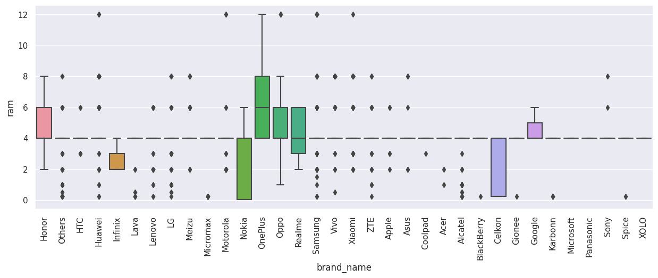
EDA Results: Bivariate Analysis : RAM vs Brand Name
OnePlus tends to have the largest ram sizes while the least ram sizes are generally registered for Nokia and Celkon
Most other brands essentially have ram sizes of 4 GB and little or no variation in their ram sizes
Link to Appendix slide on data background check

Slide 23
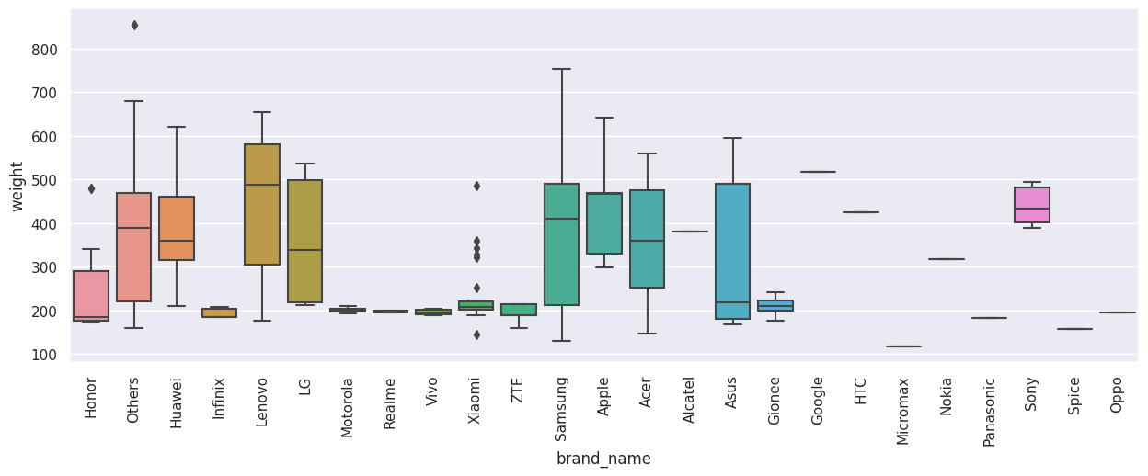
EDA Results: Bivariate Analysis : Weight vs Brand Name for Devices with large batteries (Greater than 4500 mAh)
341 devices have battery sizes greater than 4500 mAh
Among these devices, Google devices tend to be the heaviest while Micromax tend to be the lightest and both brands have little or no variation in weight
Among these large-battery devices, Lenovo, LG, Samsung, and Asus, show relatively large variation in weight
Link to Appendix slide on data background check

Slide 24
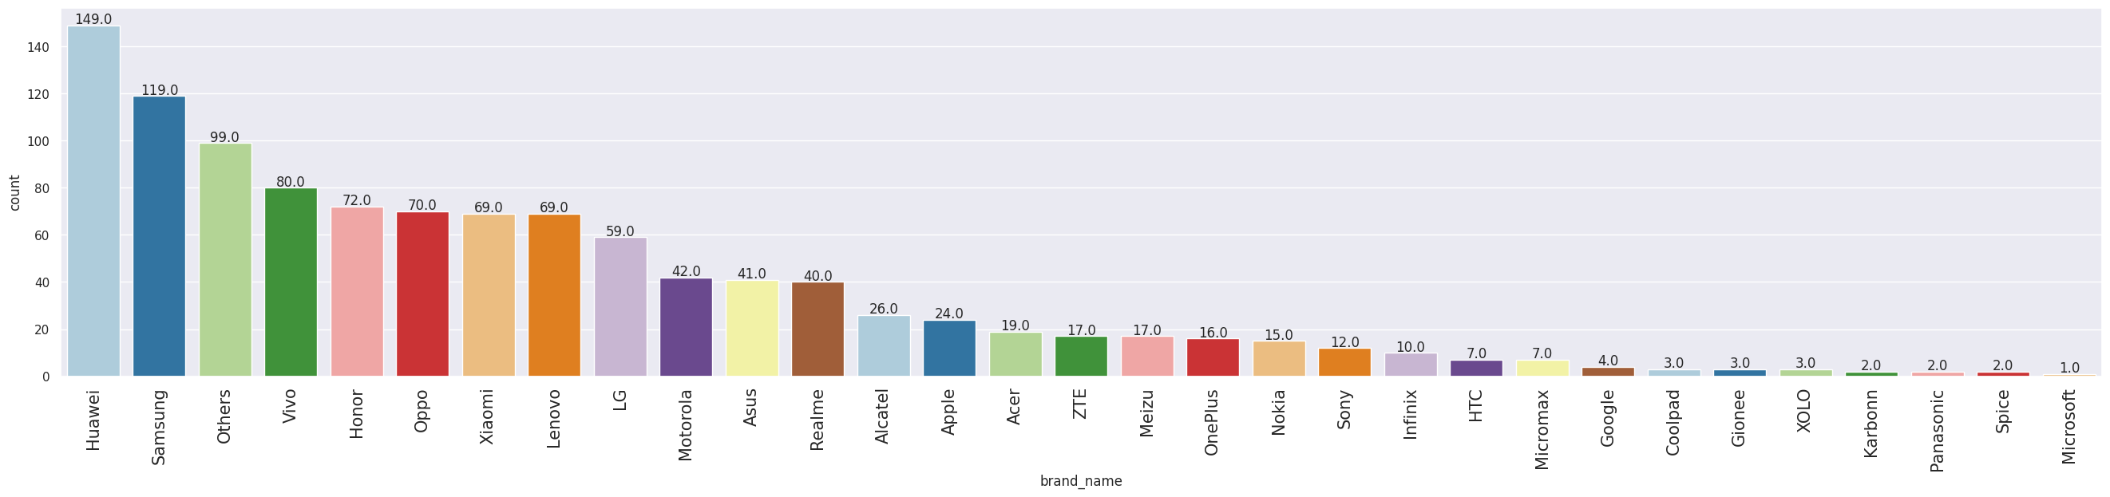
EDA Results: Bivariate Analysis : Brand Name for large-screen (greater than 15.24 cm) Devices
The screen sizes of 1099 devices are larger than 15.24 cm
Among these devices, most are Huawei devices (149) followed by Samsung (119)
Only one is a Microsoft device
Link to Appendix slide on data background check

Slide 25
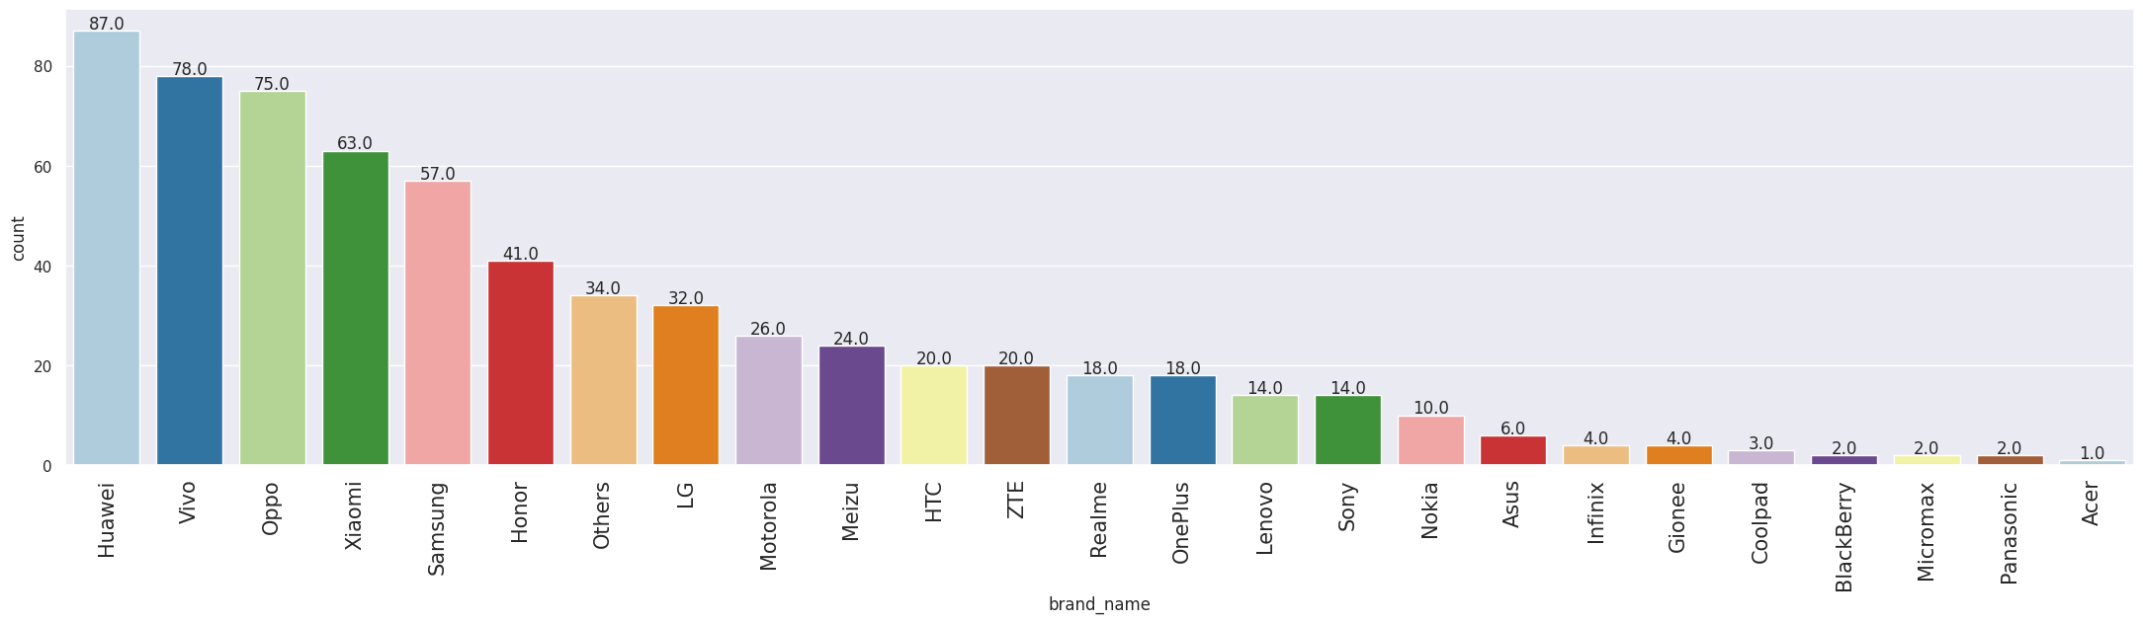
EDA Results: Bivariate Analysis : Brand Name for high-resolution (greater than 8 megapixels) front camera Devices
655 devices have selfie camera resolution greater than 8 megapixels
Huawei once again tops the list of brands, in this case, of number of devices having a selfie camera resolution greater than 8 megapixels (87), followed by Vivo (78)
Only one of these devices is an Acer
Link to Appendix slide on data background check

Slide 26
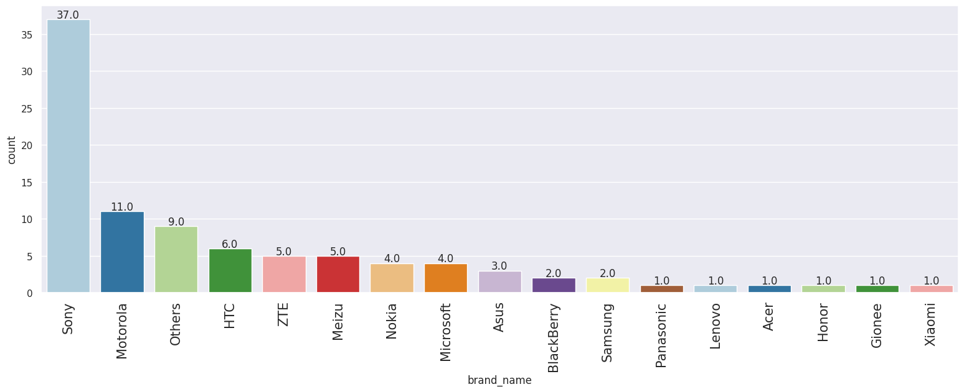
EDA Results: Bivariate Analysis : Brand Name for high-resolution (greater than 16 megapixels) rear camera Devices
94 devices have main camera resolutions greater than 16 megapixels
Now, Sony tops the list of brands for devices having a main camera resolution greater than 16 megapixels (37) and is followed from afar by Motorola (11)
Among these devices, Panasonic, Lenovo, Acer, Honor, Gionee, and Xiaomi are represented, each, by only one device
Link to Appendix slide on data background check

Slide 27
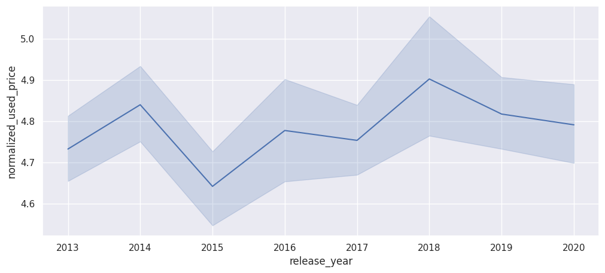
EDA Results: Bivariate Analysis : Normalized Price of Used Devices vs Year of Release
The normalized price of used devices has an undulating yet generally increasing trend from 2013 to 2020
Link to Appendix slide on data background check

Slide 28
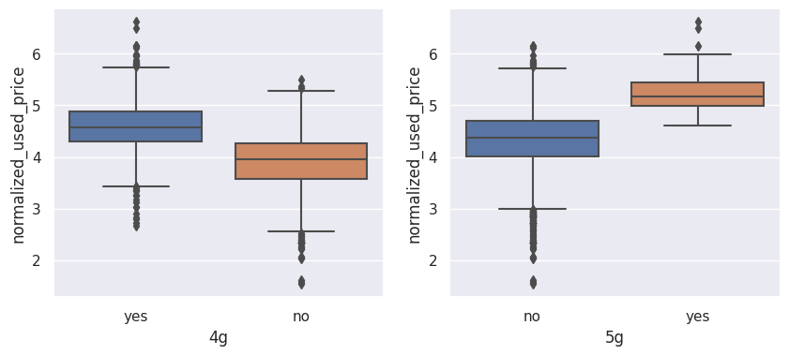
EDA Results: Bivariate Analysis : Normalized Price of Used Devices vs 4g- and 5g-compatibility
4g: The normalized prices of used devices is approximately 0.6 normalized price greater for 4g-enabled devices; the variation is slightly larger for non 4g-enabled devices; and the outliers are registered on both sides of each of the two distributions
5g: The normalized prices of used devices is generally almost 1 normalized price greater for 5g-enabled devices; the variation is slightly greater for non 5g-enabled devices; outliers are registered on both sides of non 5g-enabled devices and on the right of 5g-enabled devices
Link to Appendix slide on data background check

Slide 29
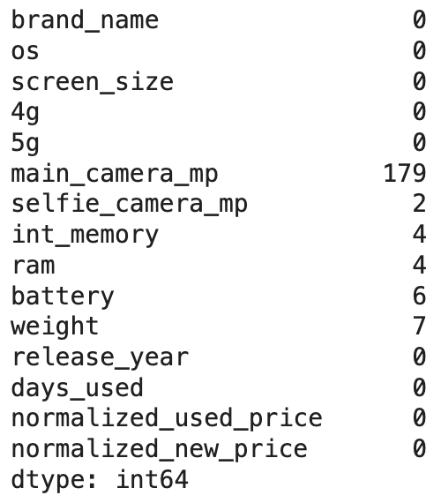
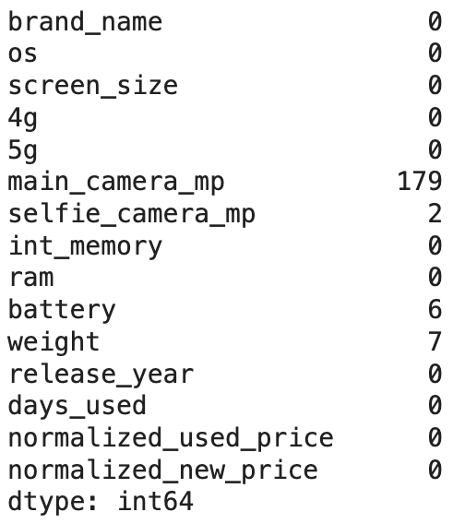
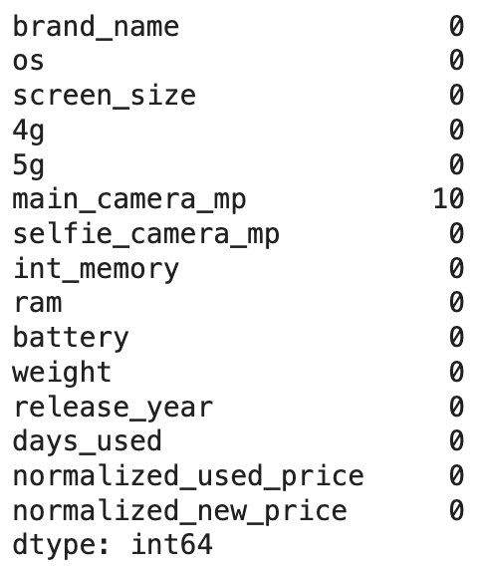
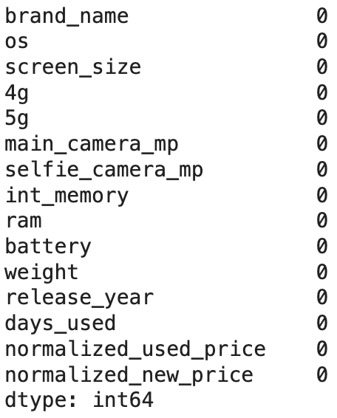
Data Preprocessing: Duplicate value check and Missing value treatment
0: Null Untreated
1: Imputation of Median Grouped by Release year and Brand Name
The data contains no duplicates
main_camera_mp, selfie_camera_mp, int_memory, ram, battery, and weight (6 columns) all contain missing values
After first imputation of medians grouped by year of release and brand name (assuming that the prices for a given brand in a specific year are close to one another), we have 4 columns with missing values: main_camera_mp, selfie_camera_mp, battery, and weight
A second imputation of medians grouped by brand name results in one column still having missing values: main_camera_mp
A final imputation of the median of main_camera_mp imputed to the missing values of this column eradicates the remaining missing values
2: Imputation of Median Grouped by Brand Name
3: Imputation of the Median of the Main Camera Resolution

Slide 30
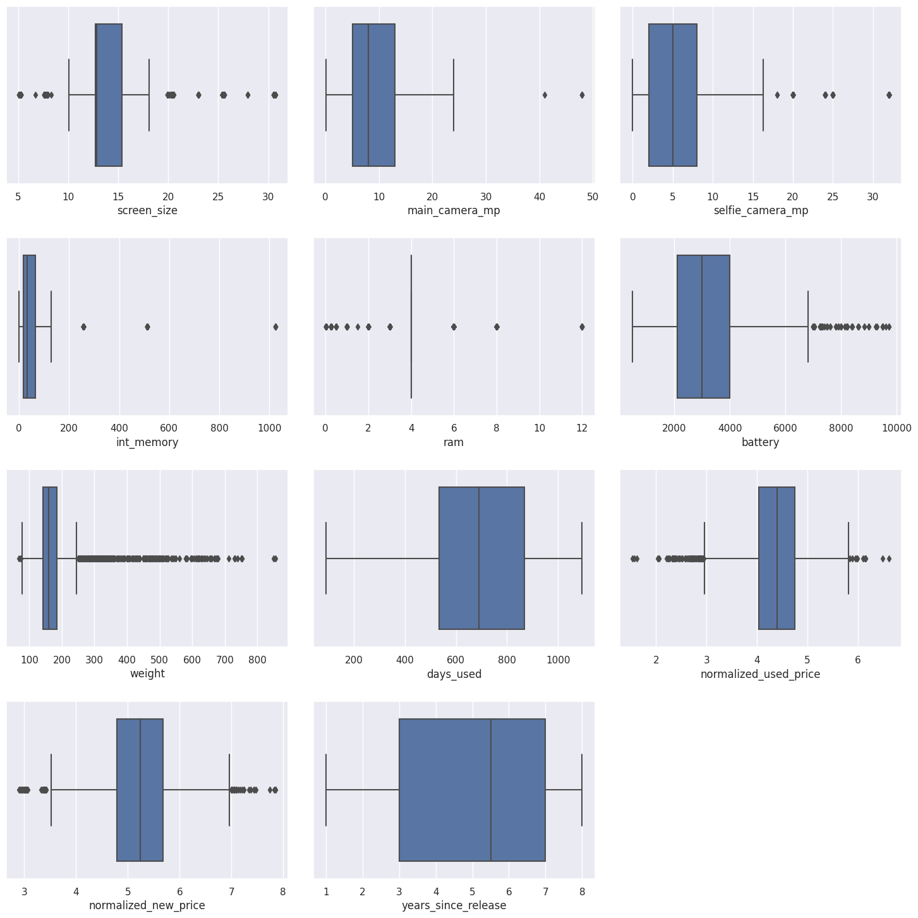
Data Preprocessing: Outlier check
All the numerical variables have outliers except days_used and years_since_release, but we have no reason to consider any of the values extraneous

Slide 31
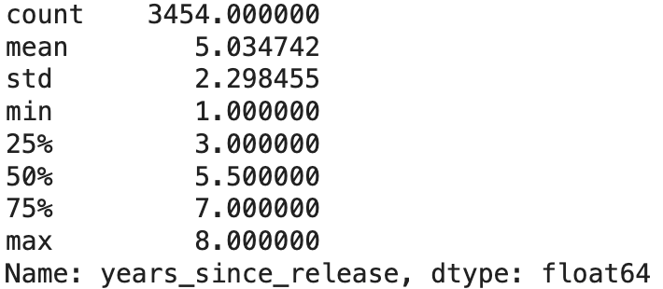
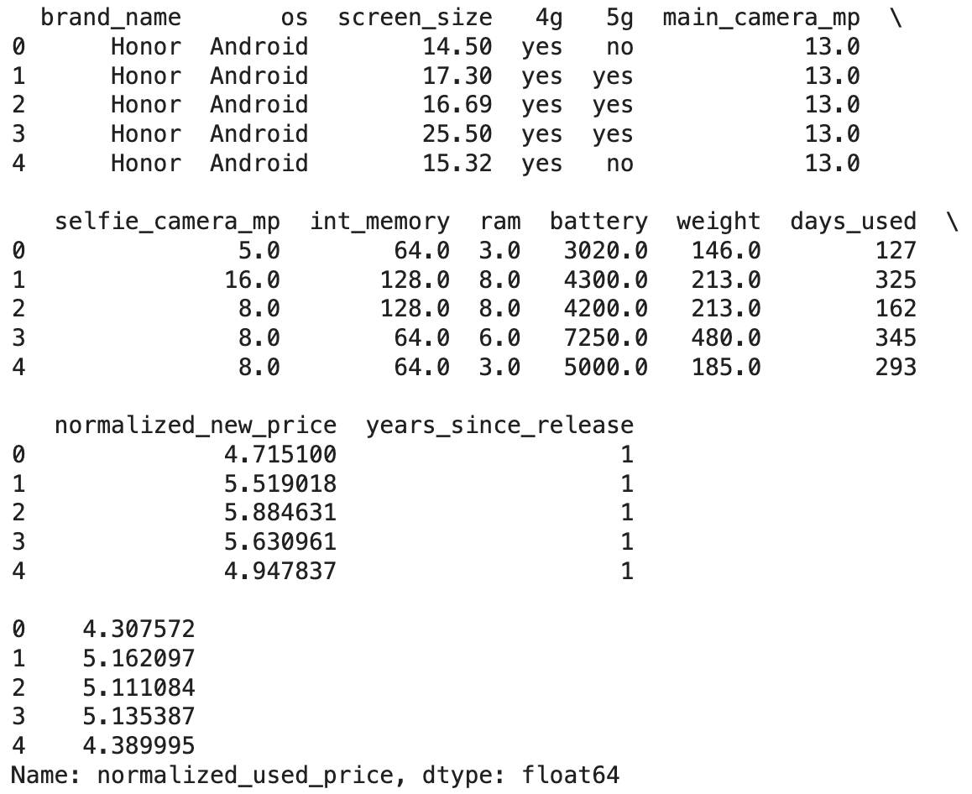
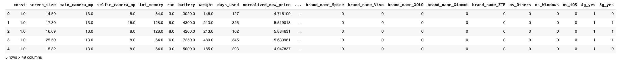
Data Preprocessing: Feature Engineering and Data Preparation for Modeling
The devices were released 1 to 8 years before 2021
On average, the devices were released 5 years before 2021
The dummy-transformation of categorical columns has moved the number of columns to 49
The train data has 2417 records meanwhile the test data has 1037 records

Slide 32
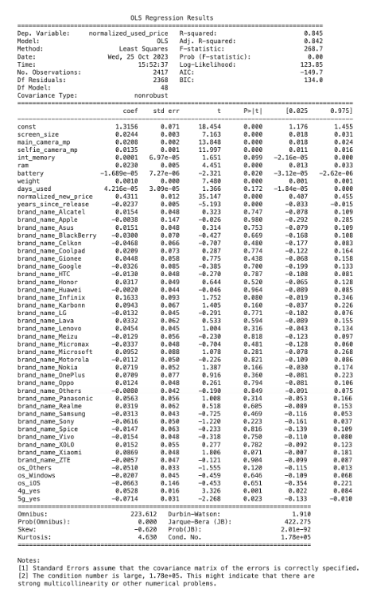
Model Building: Primary Model
The Adjusted R-Squared is 0.842, which is good (about 84% of the variance is explained by the model)
The const coefficient(y-intercept) is 1.3156
The coefficient of normalized_new_price is 0.4311
days_used and the dummy variables of the brand and os categorical variables all have p-values greater than the level of significance (0.05) and thus will have to be trimmed and the model regenerated and reassessed
Link to Appendix slide on model assumptions

Slide 33
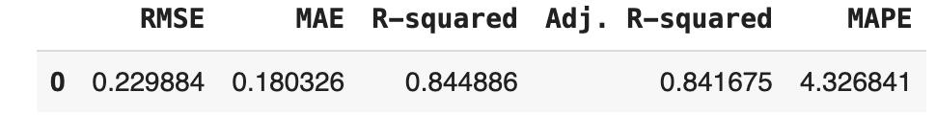
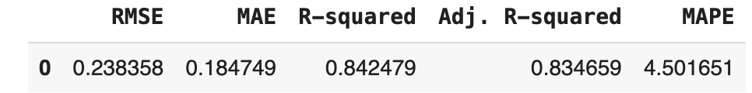
Model Building: Model Performance Check
Training Performance
The training R-squared is 0.84, so the model is not underfitting
The train and test RMSE and MAE are comparable, so the model is not overfitting either
MAE suggests that the model can predict the normalized price of used devices within a mean error of 0.18 on the test data
MAPE of 4.5 on the test data means that we are able to predict within 4.5% of the normalized price of used devices
Test Performance
Link to Appendix slide on model assumptions

Slide 34
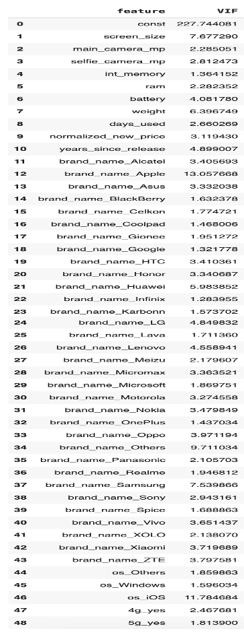
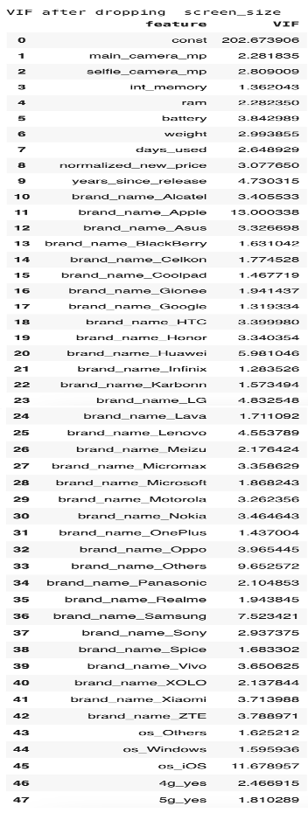
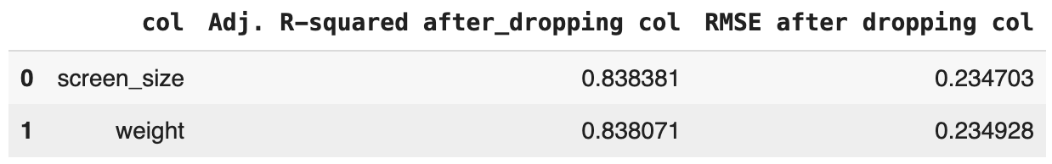
Model Building: Checking Linear Regression Assumptions: Treatment of multicollinearity
screen_size and weight display moderate multicollinearity while
we will be ignoring the vif of dummy variables
We will drop screen_size since dropping it has the the least impact on R-squared
After dropping screen_size, the VIFs of all the non-dummy predictor variables are below 5; thus, we have eliminated multicollinearity from the data used for the model
Link to Appendix slide on model assumptions

Slide 35
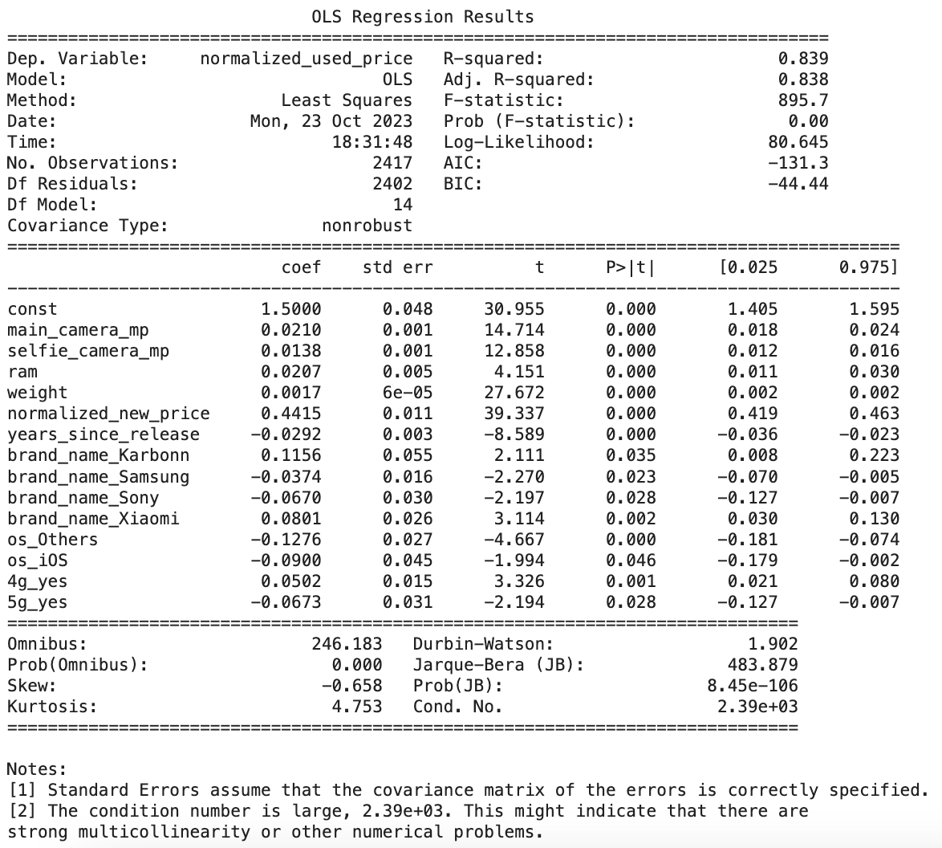
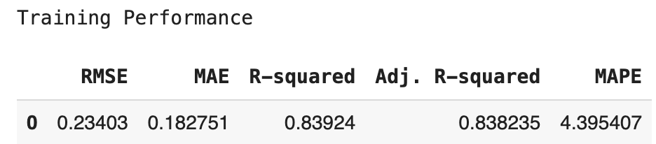
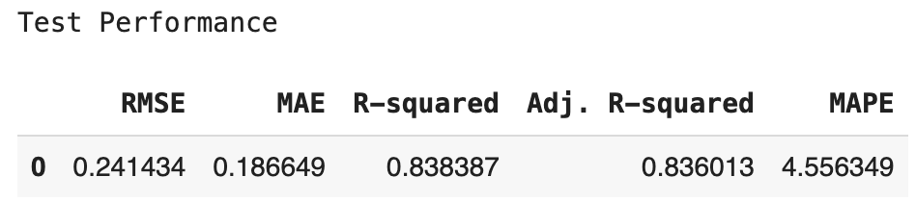
Model Building: Checking Linear Regression Assumptions: Dropping high p-value variables
After eliminating the predictor variables with high p-values, the list of variables (excluding the y-intercept) to be used for the model reduces to 14 variables
Now no feature has p-value greater than 0.05, so we'll consider the features in x_train3 as the final set of predictor variables and olsmodel2 as the final model to move forward with
The adjusted R-squared is now 0.838, i.e., our model is able to explain ~84% of the variance (not very far from the value, 0.842, of olsmodel1); thus, variables dropped did not significantly affect the model
RMSE and MAE values are comparable for train and test sets, indicating that the model is not overfitting
MAE suggests that the model can predict the normalized price of used devices within a mean error of 0.19 on the test data
MAPE of 4.56 on the test data means that we are able to predict within 4.56% of the normalized price of used devices
Link to Appendix slide on model assumptions

Slide 36
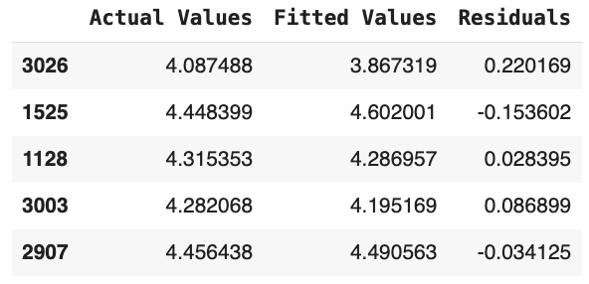
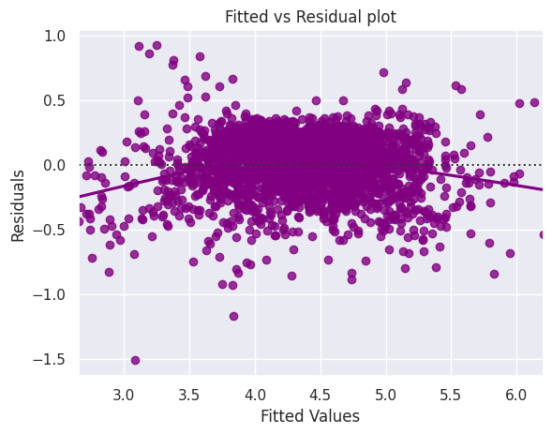
Model Building: Checking Linear Regression Assumptions: Test for Linearity and Independence
The assumptions of linearity and independence are satisfied since the plot has no discernible pattern
Link to Appendix slide on model assumptions

Slide 37
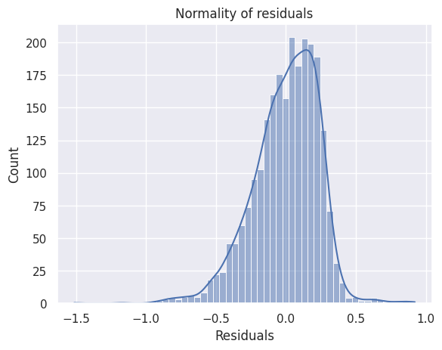
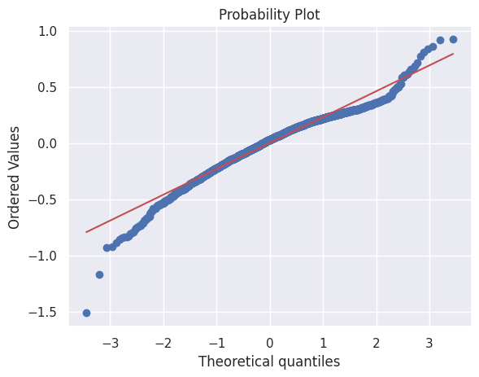
Model Building: Checking Linear Regression Assumptions: Test for Normality and Homoscedasticity
The distribution of residuals is somewhat bell-shaped
The Q-Q plot of residuals follows a straight line for the most part
The p-values (0.44) of the goldfeldquandt test is greater than 0.05 and, thus, we fail to reject the null hypothesis; in other words, we can conclude that residuals are homoscedastic
Link to Appendix slide on model assumptions

Slide 38
Model Performance Summary
We used the Ordinary Least Squares (OLS) Method to design our model
After imputation of missing values and engineering of the years since release column, the data was split into a y-variable (normalized_used_price) and a series of X-variables (containing the other columns); and a constant (intercept) was added to the X-variables series
The categorical columns of X (brand_name, os, 4g, and 5g) were dummy-transformed in preparation for the model building
As a final step before the model building, the data (y- and X-variables) were split into training and test data in a ratio of 70:30
After building the model and tuning it to eliminate multicollinearity and high p-values for significance, we arrived at a model with the following principal features:
The adjusted R-squared is 0.838, i.e., our model is able to explain ~84% of the variance
RMSE and MAE values are comparable for train and test sets, indicating that the model is not overfitting
MAE suggests that the model can predict the normalized price of used devices within a mean error of 0.19 on the test data
MAPE of 4.56 on the test data means that we are able to predict within 4.56% of the normalized price of used devices
Link to Appendix slide on model assumptions

Slide 39
APPENDIX

Slide 40
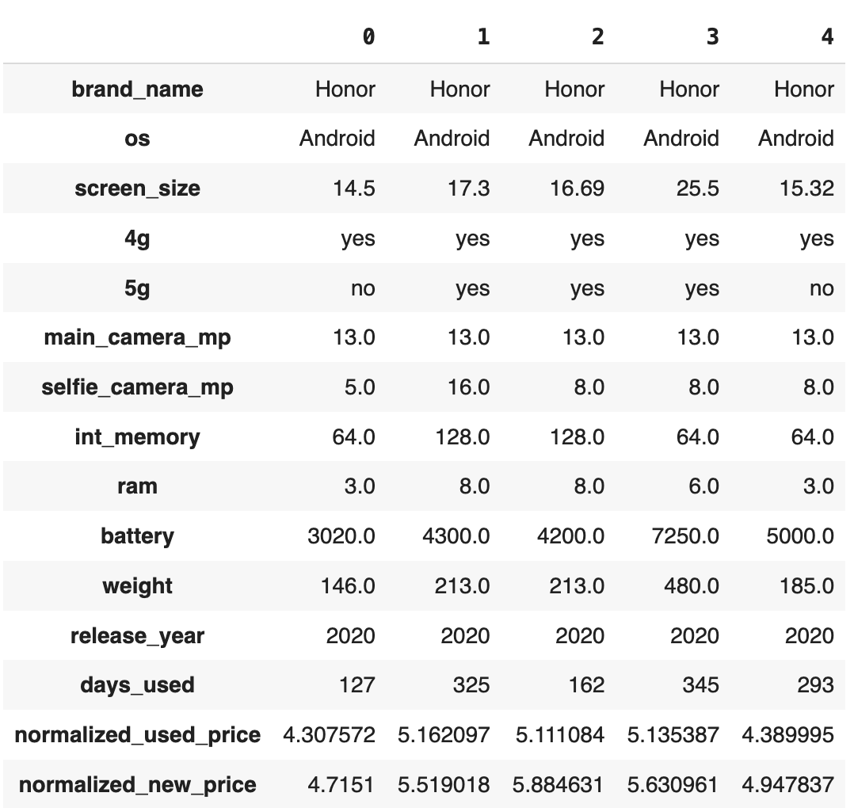
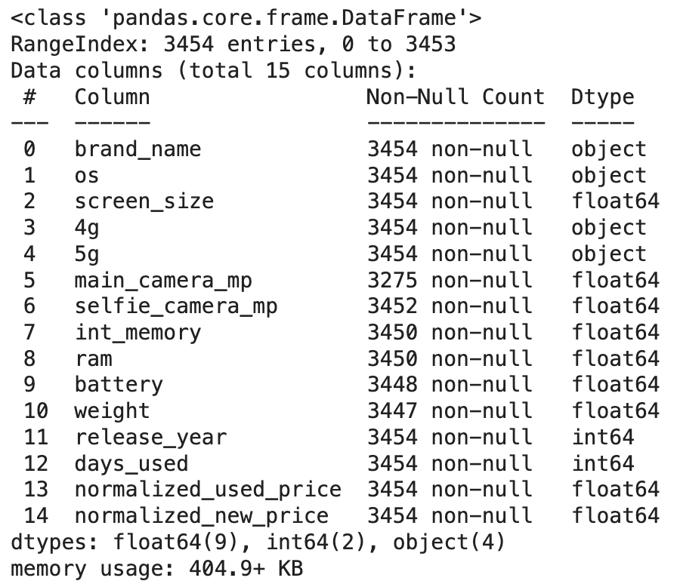
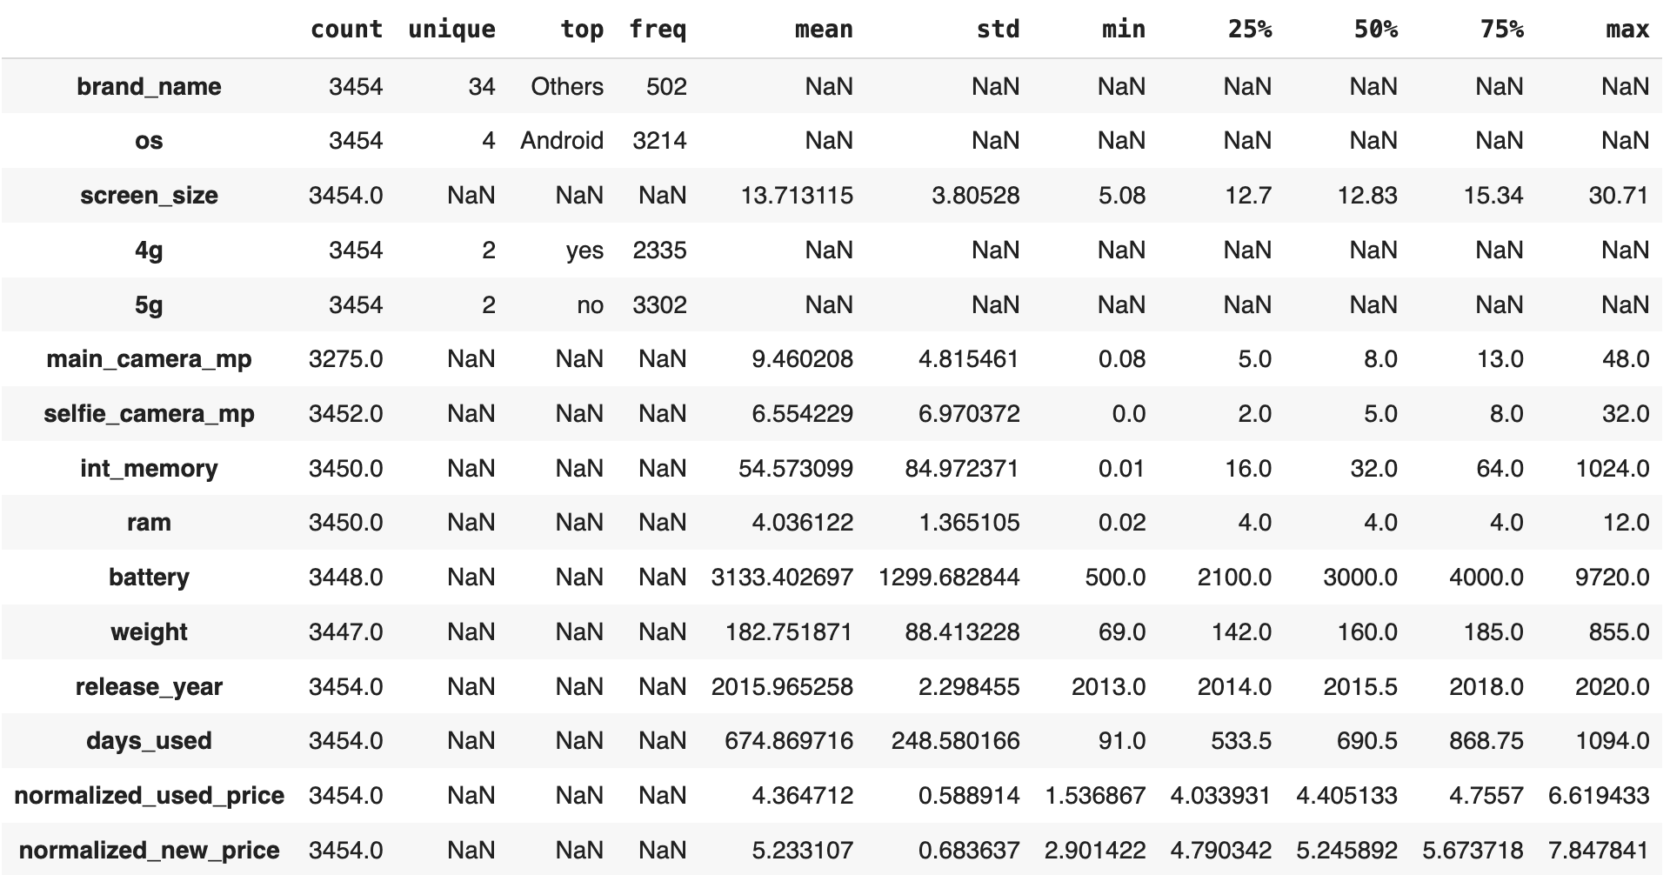
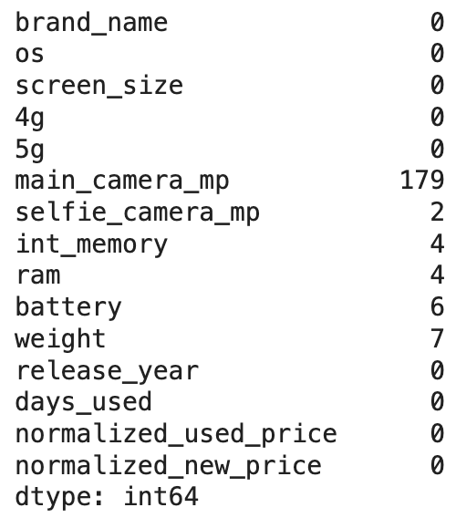
Data Background and Contents: Data Overview
The data contains 3454 rows (records) and 15 columns (attributes)
The data contains 4 categorical columns (object) and 11 numerical columns (9 float, 2 int)
The normalized price for used devices ranges from 1.54 to 6.62 with an average of 4.36 and median of 4.41 giving the impression that the distribution is almost normal (since the mean and median are close)
The normalized price of new devices ranges from 2.90 to 7.85 with an average of 5.23 and a median of 5.25; probably also having a normal distribution
The brand names of several devices (502) are not identified
Android is the most popular operating system (3214)
Most devices are 4g-enabled (2335) but many more do not support 5g (3302)

Slide 41
Model Assumptions
Variance Inflation Factor (VIF)
The VIF was used to test for multicollinearity
screen_size and weight had VIF values between 5 and 10 and, thus, showed moderate levels of multicollinearity
The multicollinearity was completely eliminated by excluding screen_size
Fitted versus Residual Plot
The Fitted (predicted values) vs Residual (error – difference between predicted and actual values) plot was used to test for linearity and independence
No pattern was identifiable from the plot; thus, the assumptions of linearity and independence were satisfied
Distribution of Residuals , Quantile-Quantile (Q-Q) plot, and Shapiro-Wilks test
The Q-Q plot (plot of ordered values vs theoretical quantiles ) was used to test for normality
Most of the plotted values followed the theoretical 45 degrees line, thus demonstrating that the distribution of the residuals is approximately normal
The approximate normal distribution of the residuals was confirmed by the corresponding distribution plot
However, the Shapiro-Wilks test showed departure from strict normality by producing a p-value less than 0.05
Goldfeldquandt test
The goldfeldquandt test was used to test for homoscedasticity
The goldfeldquandt test produced a p-value greater than 0.05, thus preventing rejection of the null hypothesis; so, we concluded that the residuals are homoscedastic

